Slide 1
Network Programming
Tutorial 2

Slide 2

Prepare your Phone and Scan

Slide 3
Multi-Threading
What is a thread?
What is a multi-threaded program then?
What is a single-threaded program?
It’s the flow of execution of a sequence of instructions
A program consisting of multiple threads running in parallel
A program consisting of one thread

Slide 4
What should you Know?
When you first run the program, you are creating the very first thread called the main thread
All of the program’s threads are started in the main thread
1
2
All of the threads (main and started) share the same code and data
The main thread can wait for the threads to complete execution before terminating or can directly terminate.
3
4

Slide 5
Muli-threading in Python

Slide 6
Multi-threading in Python
01
02
03
04
You need the threading library: import threading
To create a thread, use the Thread function:
t=threading.Thread(target, args)
Run the thread using the start function:
t.start()
If you want the main thread to wait for the created to finish execution, use the join function:
t.join()
If you want to know how many threads are running (main and created), use the activeCount function: threading.activeCount()
05
Note: There are many other functions you can lookup for online.

Slide 7
Let’s Code

Slide 8
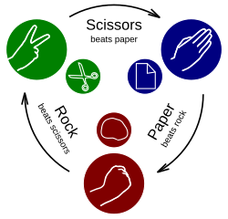
Your turn!
Implement a rock-paper-scissors game between the server and the client.
The server should be able to handle multiple clients at the same time.
Make use of TCP connections.
We don’t want the server’s output to be predictable so make use of the random library.

Slide 9
Traditional architecture
Traditionally, a network application follows a client-server approach.
Sometimes, clients need to communicate with one another (the entire application might be based on that).
By following the traditional architecture, the communication between clients must always go through the server
This can put too much load on the server if the number of clients is too large
To reduce the load on the server, we can follow a peer-to-peer architecture

Slide 10
Peer-to-peer architecture
The idea here is to have the clients directly communicate with one another.
For this to work, the clients need to know each other’s address:
We can hard code the addresses from the start (to use only if the addresses remain the same)
  We can have a server that stores the clients’ addresses and forward them to the respective target clients
This approach helps reduce the load on the main server as well as the communication delay
The communication between clients can be done using TCP or UDP (depending on the requirements)

Slide 11
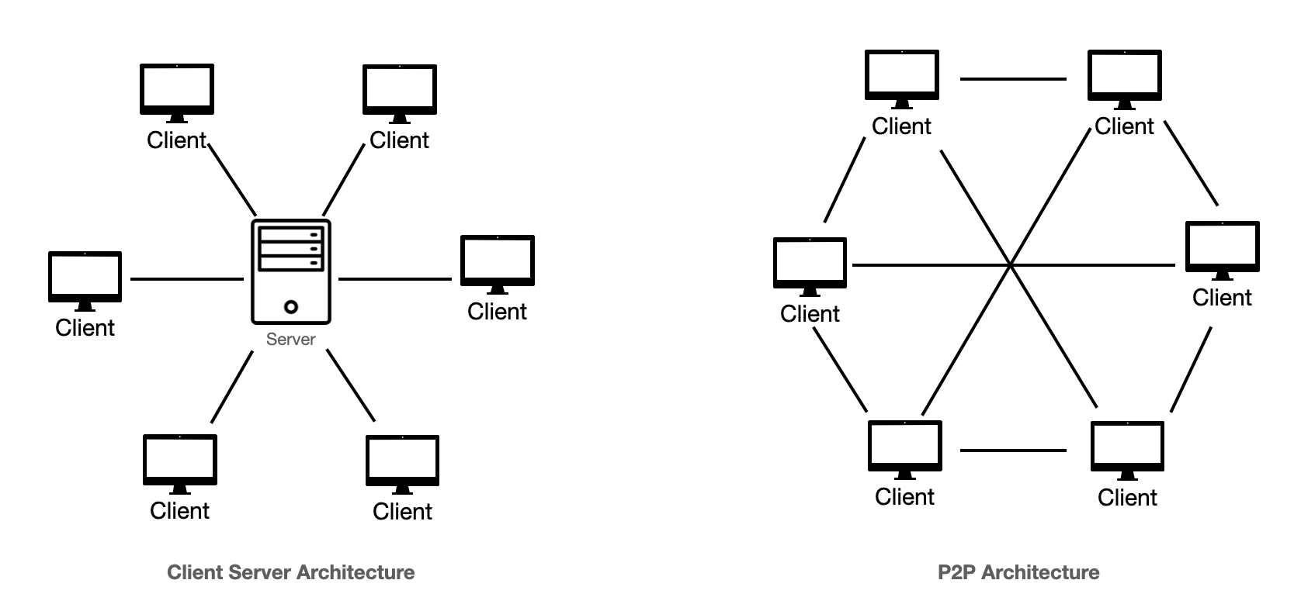
Traditional vs P2P architecture

